Slide 1
Sanitary Engineering
Sewerage Engineering
Definitions
By
Dr. Muhanad M. Abbas

Slide 2
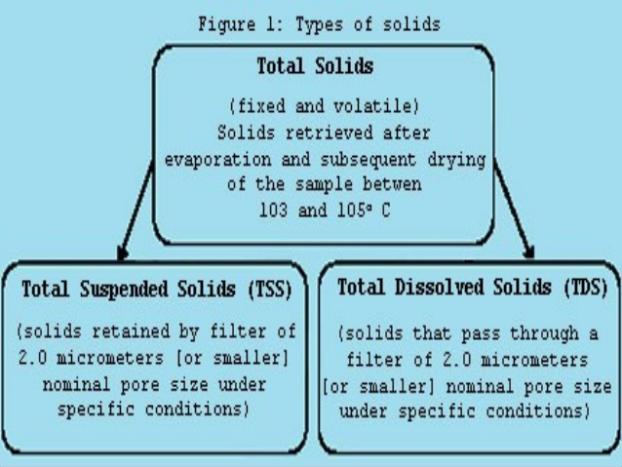

Slide 3
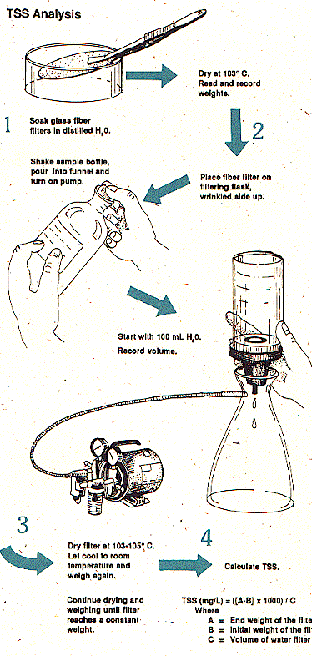

Slide 5
